Slide 1


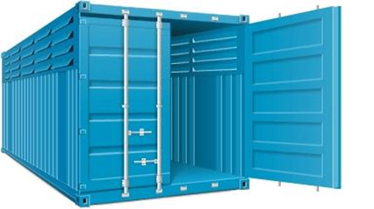
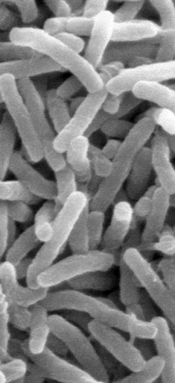




nsroot: Minimalist Process Isolation Tool Implemented with Linux Namespaces
Inge Alexander Raknes, Bjørn Fjukstad, Lars Ailo Bongo,
UiT The Arctic University of Norway
(larsab@cs.uit.no)
NIK’18, Grand Hotel Oslo, 29.11.17

Slide 2
Summary
nsroot - minimalist container
200-250 lines of C code (excluding argument parsing etc)
You can understand everything!
You(r) students could implement this
https://github.com/uit-no/nsroot

Slide 3
Outline
Containers – background and motivation
ELIXIR – distributed infrastructure for life science
nsroot – minimalist container implementation

Slide 4
From virtual machines to containers
Virtual machines (VMs):
Run many operating systems on one machine
Old idea: IBM VM/370 released in 1972 Euclid 300BC
Renewed interest with move to data centers/ clouds
Virtual machine monitors:
Layer below operating system
Presents hardware interface to an OS
Multiplex resources between several VMs
Isolates VMs from each other
Isolation:
Separate address spaces
Performance isolation (to some degree)
Key challenge: minimize cost per VM

Slide 5
From virtual machines to containers
Containers: lightweight process virtualization
Give illusion that many operating systems are running on one machine
Uses namespace and cgroup subsystems
(Not a hypervisor solution like Xen or KVM that run another instance of kernel)
Old idea: FreeBSD jail described in 2000
Renewed interest last few years
Linux container:
Operating system level virtualization
Presents OS interface to a process
Multiplex resources between several processes
Isolate processes from each other
Isolation:
Separate namespace (mostly)

Slide 6
Containers vs virtual machines
Advantages:
Lightweight: uses less resources
Scalability: can run more containers on each machine
Elasticity: very low startup time
Disadvantages:
Security: …as explained by keynote

Slide 7
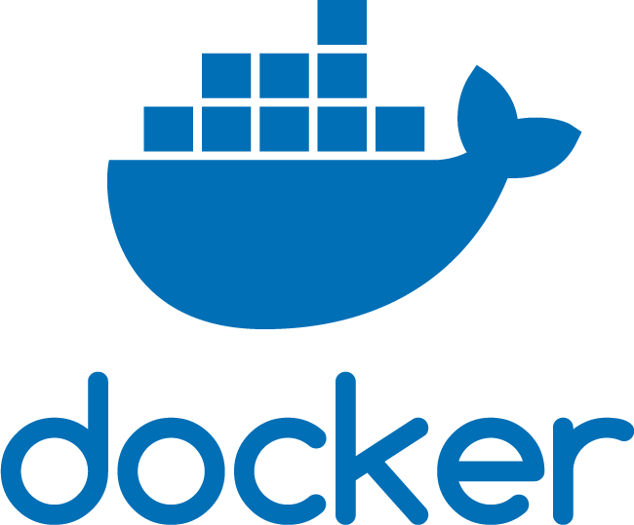
Example - Docker
FROM biocontainers/biocontainers:latest
LABEL base.image="biocontainers:latest“
LABEL version="3"LABEL software="Comet“
LABEL software.version="2016012“
…
LABEL BIOTOOLS=https://bio.tools/comet
LABEL tags="Proteomics”
MAINTAINER Felipe da Veiga Leprevost felipe@leprevost.com.br
USER biodocker
RUN ZIP=comet_binaries_2016012.zip && \ wget https://github.com/BioDocker/software-archive/releases/download/Comet/$ZIP -O /tmp/$ZIP && \ unzip /tmp/$ZIP -d /home/biodocker/bin/Comet/ && \ chmod -R 755 /home/biodocker/bin/Comet/* && \ rm /tmp/$ZIP
RUN mv /home/biodocker/bin/Comet/comet_binaries_2016012/comet.2016012.linux.exe /home/biodocker/bin/Comet/comet
ENV PATH /home/biodocker/bin/Comet:$PATH
WORKDIR /data/
CMD ["comet"]
docker build -t comet .
Or: docker pull biocontainers/comet
docker run -t comet
docker export –o comet.tar comet

Slide 8

Example container orchestration - Kubernetes
Deployment, scaling, and management of containers
Master-worker cluster configuration
Scales to ~5000 nodes

Slide 9
Containers in life sciences
Make data analysis applications easier to install, configure, port, and use:
Biocontainers: 3393 bioinformatics tool containers
Standardize data analysis:
Common workflow language: workflows using containers
Analysis reproducibility:
Walrus: tool dependency + data management
Analysis job execution:
Kubernetes

Slide 10
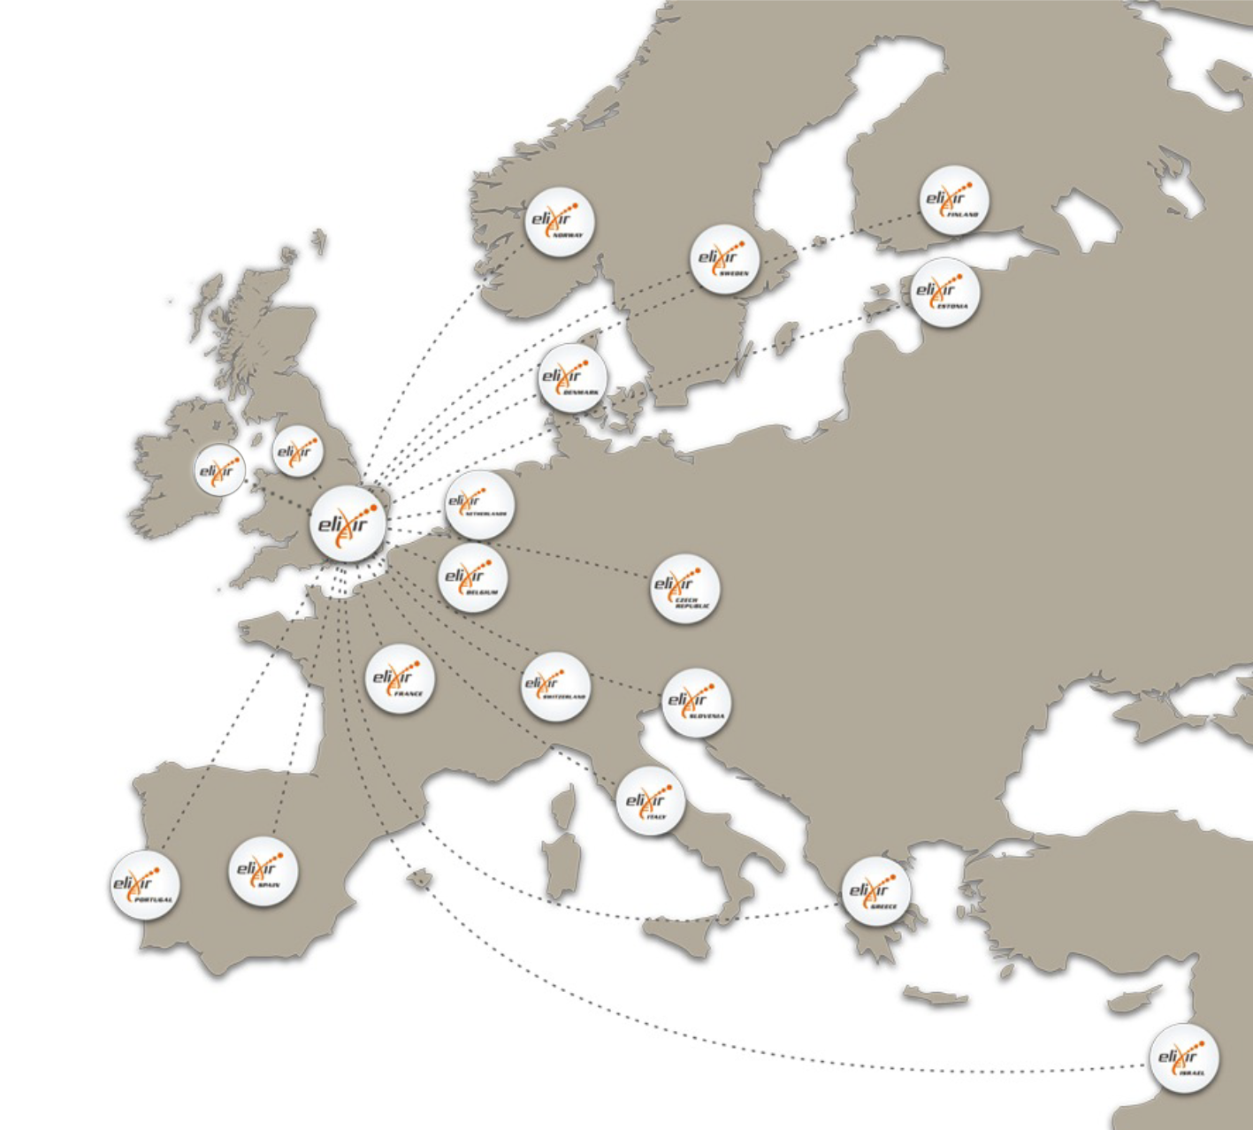










ELIXIR: An international distributed infrastructure for biological data
Technical platforms
Data
Standards
Tools
Compute
Training
User communities
Marine metagenomics
Crop and forest plants
Human data
Rare diseases

Slide 11
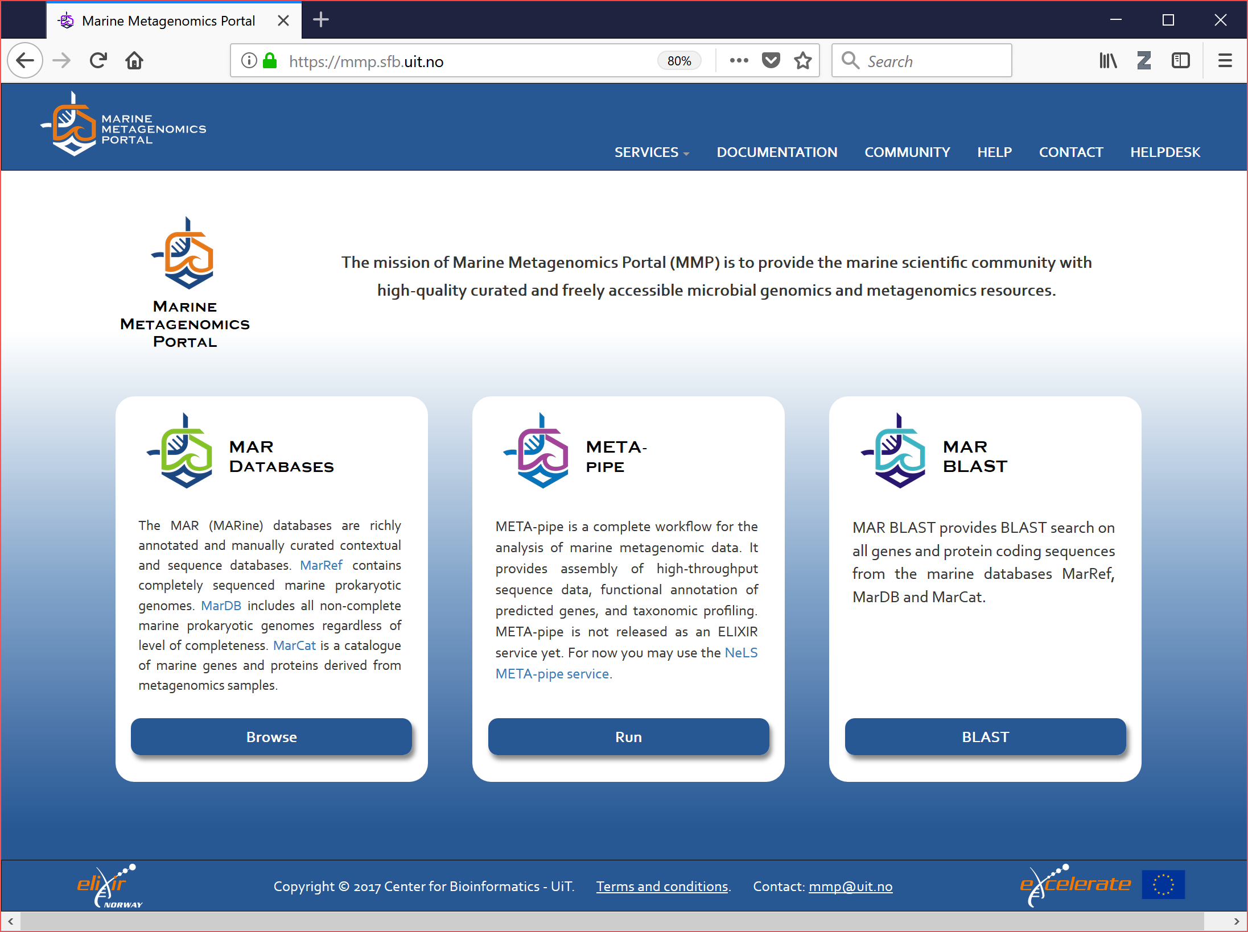
META-pipe service

Slide 12
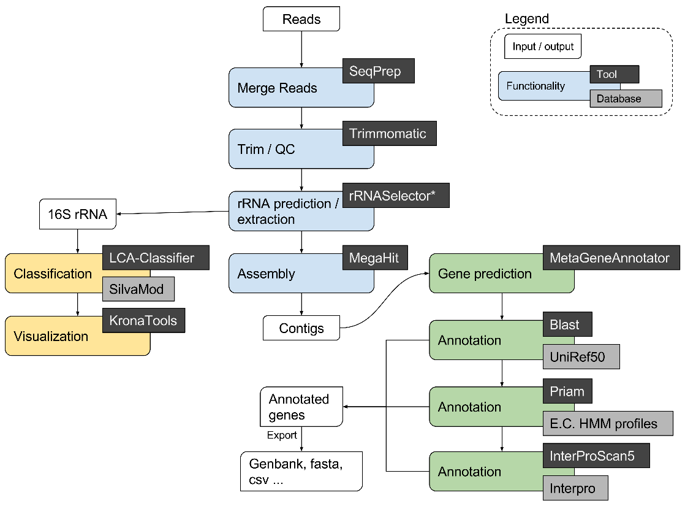


META-pipe analysis pipeline

Slide 13
Security concerns
Issues:
many 3rd party tools
that are not well tested or implemented
that process user submitted text files
run by a single user on behalf of all users
on someone else's hardware

Slide 14

Security solution
Hope and prayers
Isolation
A pipeline execution can only access one input dataset
Teardown execution environment after each pipeline execution
End-user authentication
Academic institution, ORCID credentials

Slide 15
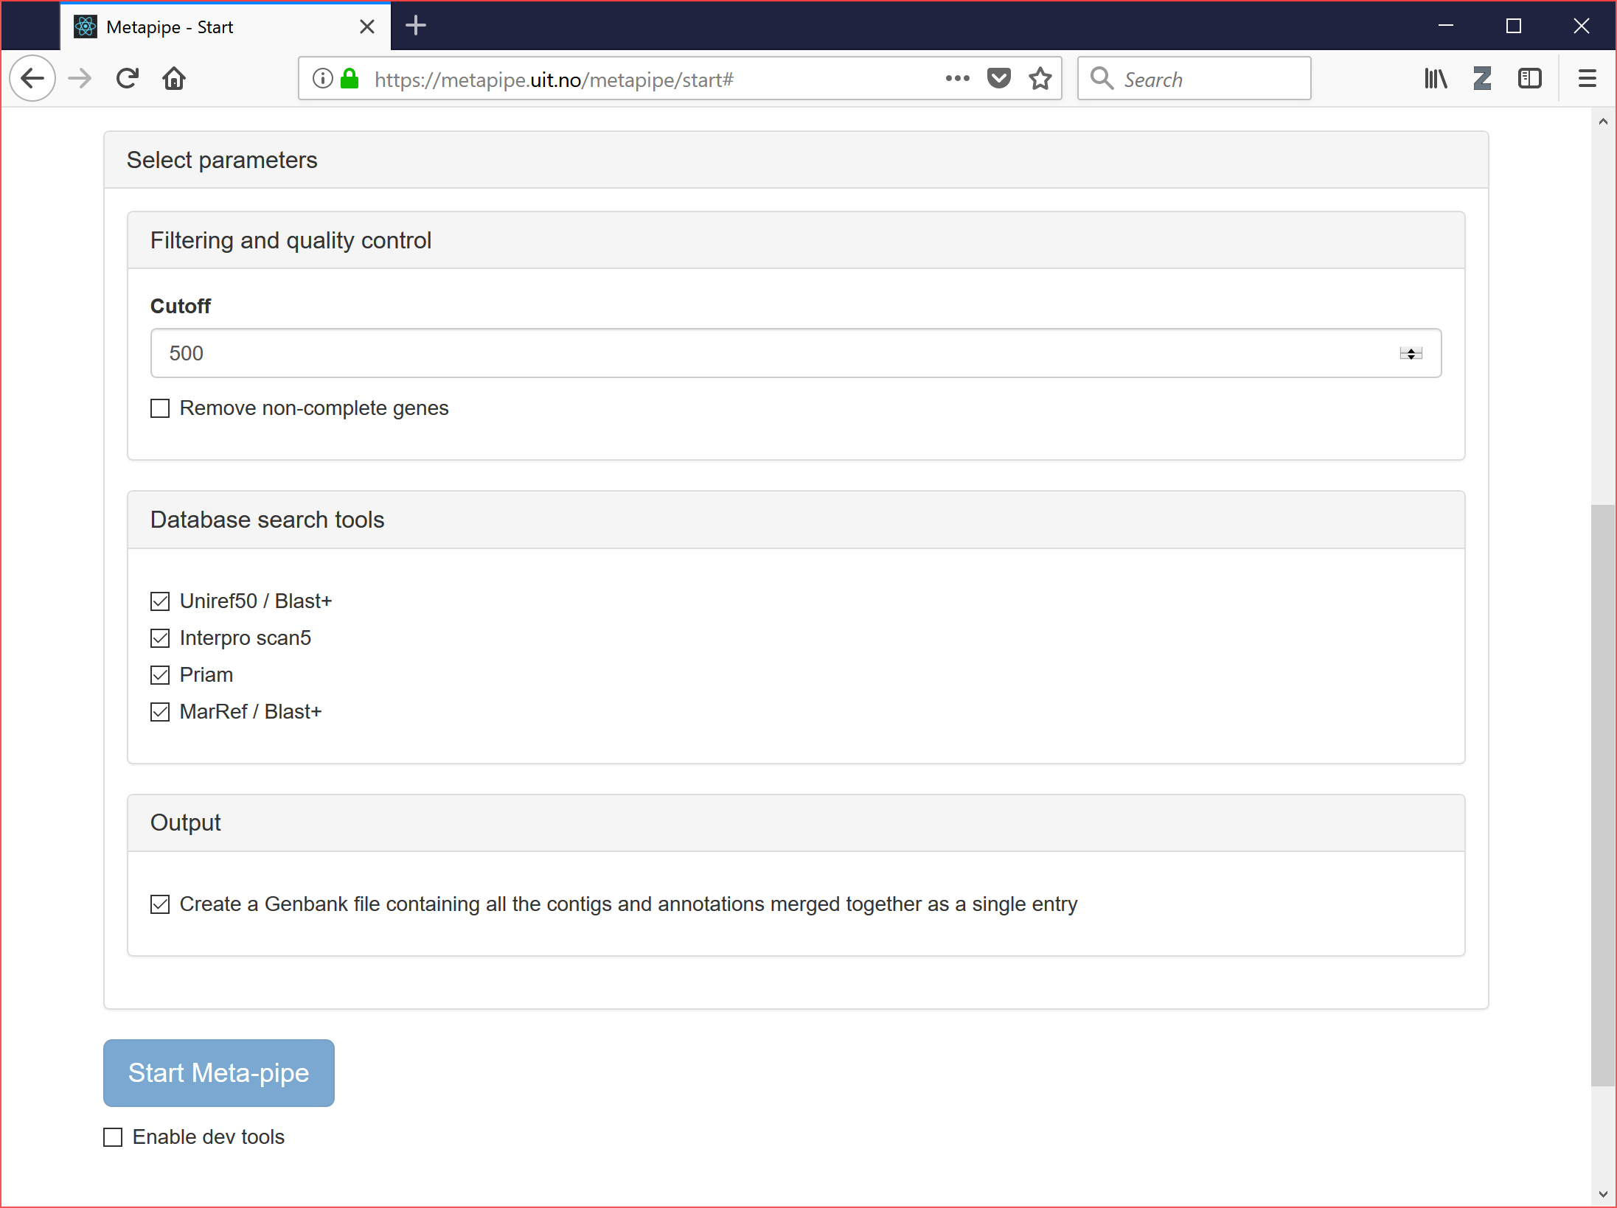

Slide 16
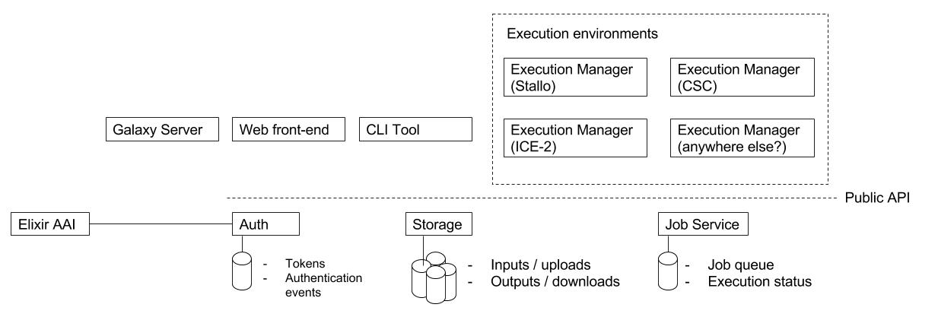
META-pipe: architecture
More info in our: Design document

Slide 17
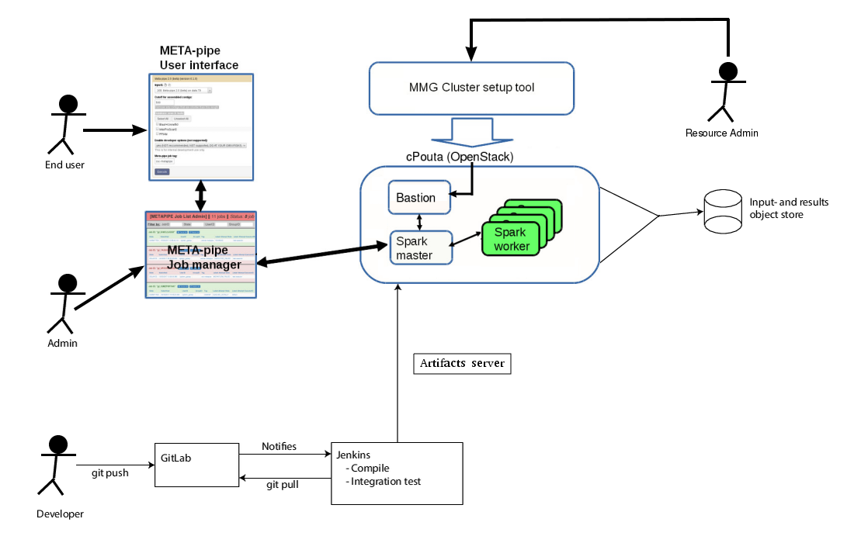
META-pipe cloud setup
Agafonov et al, F1000Research, 2017

Slide 18
META-pipe job execution
META-pipe is implemented as a Spark job with abstractions for executing 3rd party tools
Simplified: run Spark job
Spark job is a jar file
Issues:
Where to install 3rd party tools and dependencies?
Where to store (10-100GB of) reference databases?
How to maintain pipeline versions?

Slide 19
Ideal solution
Package everything into jar file
nsroot is first step
AppImage for packaging application as a single ELF executable file
Nsroot + AppImage:
Software packaging
Improved security when executing 3rd party binaries
Solves absolute path issue
nsroot + AppImage + jar:
Jar for deployment
Can use Spark for job execution
Unresolved issues: size of jar file (hundreds of GBs)

Slide 20
nsroot
Isolate 3rd party tools
Does not require root privileges
Can be used on HPC platforms
Nothing to install
Implemented using Linux namespaces
Command line interface similar to chroot
Open source at: https://github.com/uit-no/nsroot
<500 lines of code
Similar to:
nsjail and firejal

Slide 21
nsroot – Process isolation
Isolated root filesystem
Applications change root directory
with all dependencies
using mount and user namespaces
Restrict IPC and network
using IPC and network namespaces

Slide 22
nsroot - Usage
Create a new root file system with the application and all dependencies
For example by using docker export
Create new directory for the old root filesystem in a subdirectory of the new root
Needed by the PIVOT_ROOT system call
Call nsroot (with chroot parameters) to change into new root file system

Slide 23
Conclusion
Containers have many advantages for life science data analyse
ELIXIR is developing distributed infrastructure
nsroot can be part of portable, scalable, and secure data analysis
https://github.com/uit-no/nsroot

